Slide 1
Magnet Monitor Setup
This Power Point is for demonstration purposes only, when performing the Magnet Monitor setup use Direction 2236995.
Magnet Monitor Network Configuration
Load Proprietary software to the Magnet Monitor
using FE Laptop. (Note: This may already be done.)
Create a Dial-up Networking connection using a NULL Modem.
Use Microsoft Internet Explorer to connect to the
Magnet Monitor.
NOTE: The slides used in this presentation were acquired by a Laptop running Windows 2000.

Slide 2
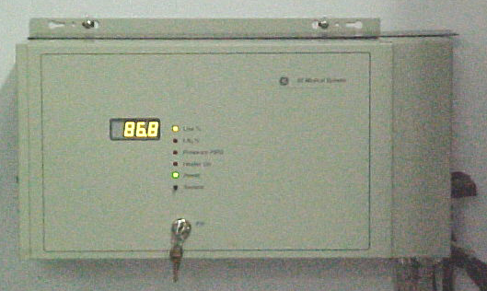
Granite Magnet Monitor
Lhe%
Lhe% Top
Pressure Psig
Heater On
Sample
Fill

Slide 3
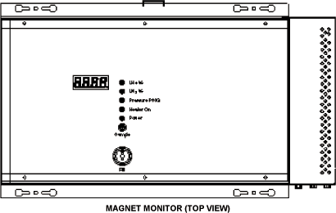
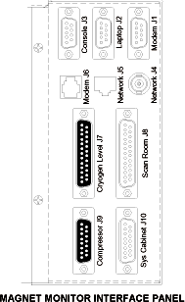
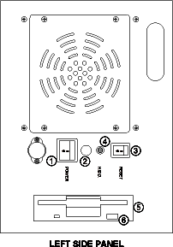
Granite Magnet Monitor
Granite Magnet Monitor
Connect a NULL Modem Cable
from the com1 port on your Laptop
to J2 (Laptop Port) on the Magnet
Monitor.
Power switch
Not used
Reset button
Hard disk access light
Floppy drive
Floppy active light

Slide 4
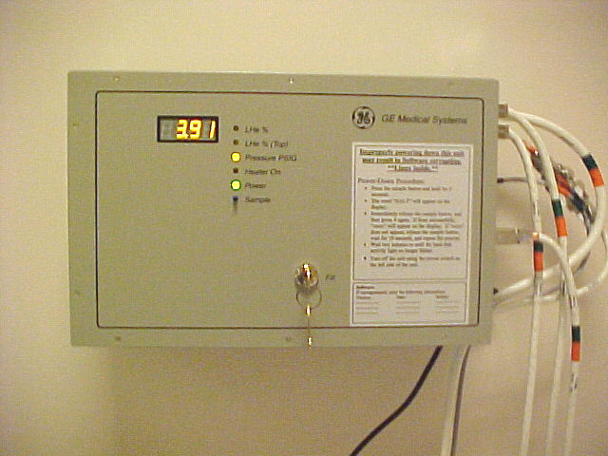
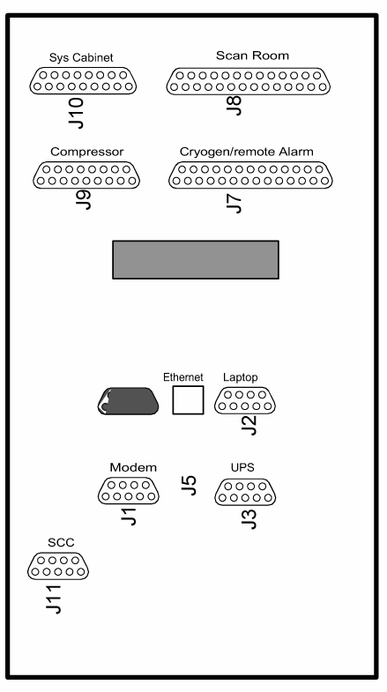
Advantech Magnet Monitor
Advantech Magnet Monitor
J2 Laptop Port
Connect a NULL Modem Cable
from the com1 port on your Laptop
to J2 (Laptop Port) on the Magnet
Monitor.

Slide 5
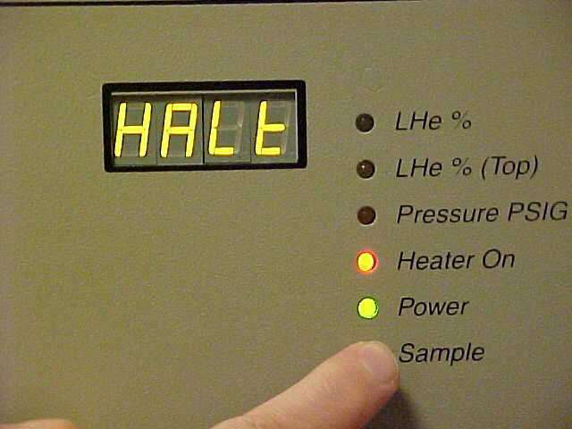
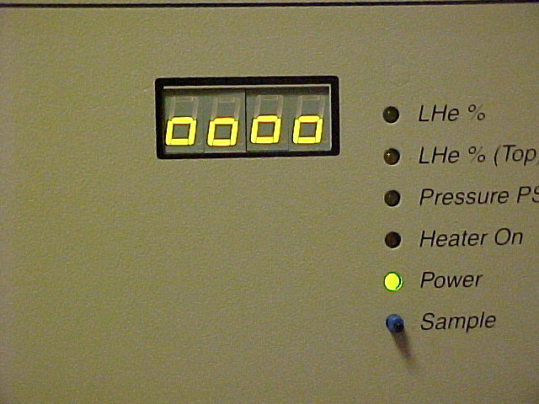
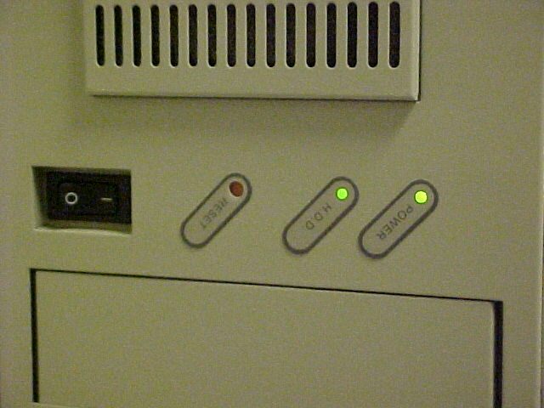
Shutting Down The Magnet Monitor
Hold the sample button in for about 4 seconds, halt should appear on the display.
If -Pb- is displayed try again.
Release the sample button for less than
1 second and then press the sample button
again, four lower case zeroes should
appear on the display.
Wait at least 90 seconds or when the
Hard Disk LED stops blinking then you
may reset or power down the MagMon
(SHeM).

Slide 6
Checking Magnet Monitor Software
If you suspect that the Proprietary Software is loaded
on the Magnet Monitor go to the Magnet Monitor Browser
Setup on slide 17 and do that setup.
Then perform the browser connection that starts on
slide 28.
If the Proprietary Software is loaded the laptop should
connect and give the following reply:
Software Revision Info:
Magnet Monitor Proprietary Software Rev. 2.3
Red Hat Linux release 6.1 (Cartman) Kernel Rev. 2.2.12-20
If the laptop does not connect check the setup and/or load the Proprietary Software starting with the Magnet Monitor Laptop Setup on the next slide.

Slide 7
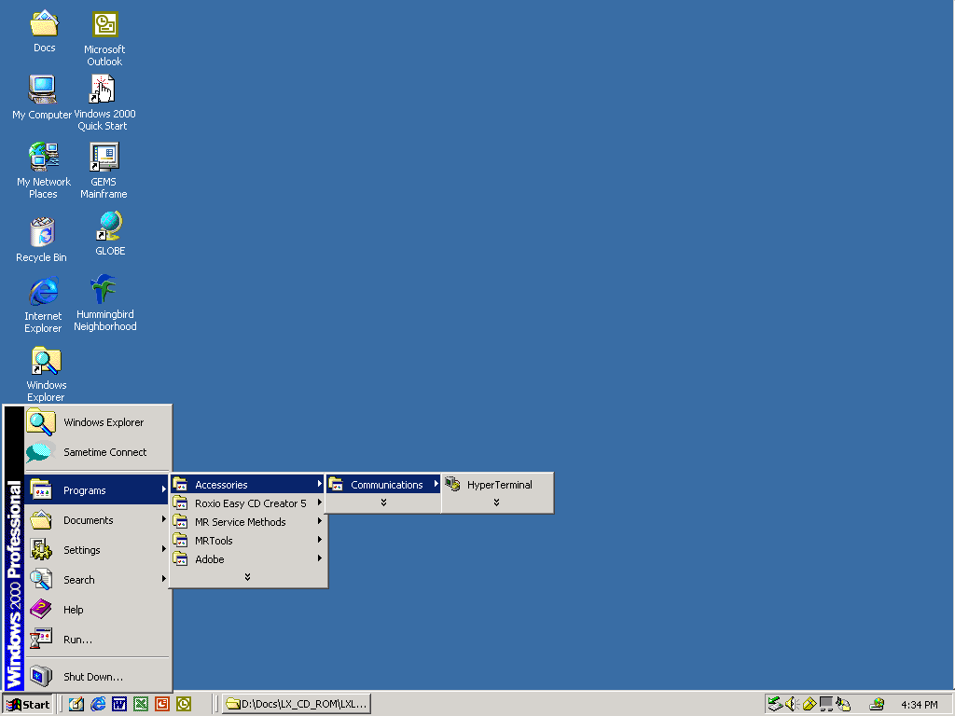
Magnet Monitor Laptop Setup
Open the Hyper Terminal Program

Slide 8
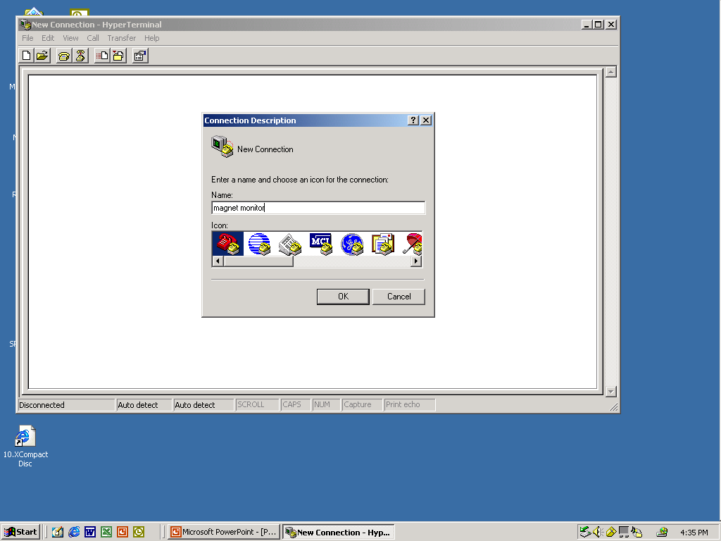
Magnet Monitor Laptop Setup
Name New Connection, Magnet Monitor

Slide 9
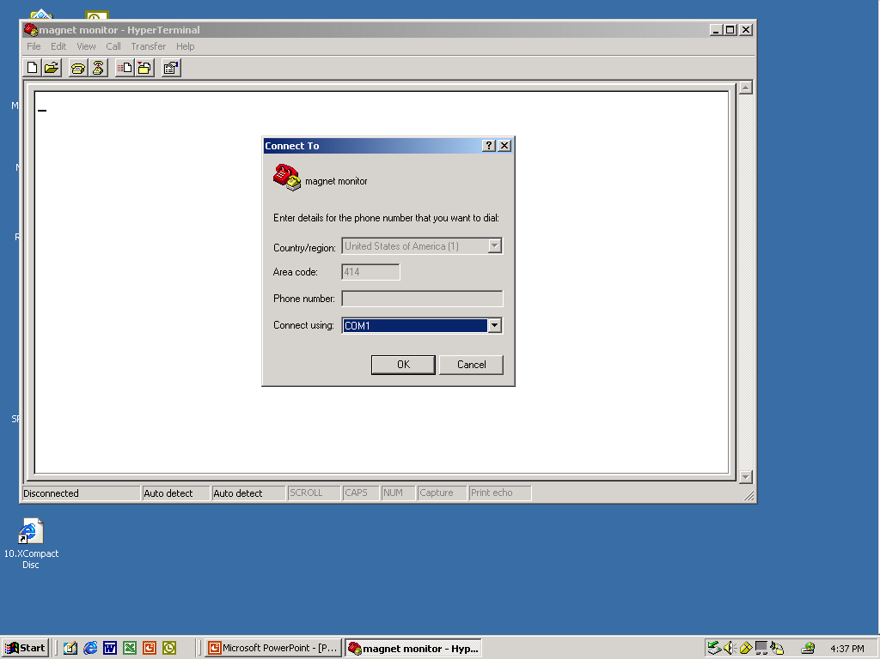
Magnet Monitor Laptop Setup
Select Connection, COM1
*NOTE: If the Laptop has PDA enabled, disable PDA.

Slide 10
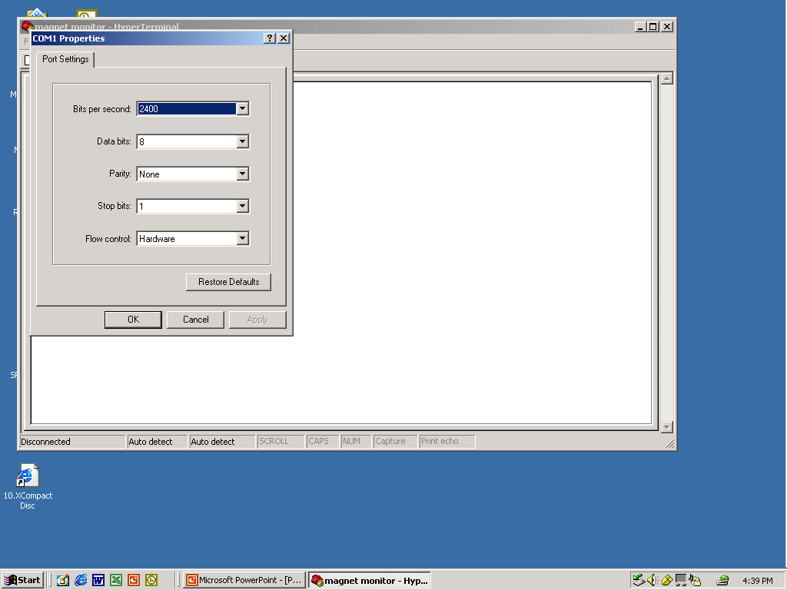
Magnet Monitor Laptop Setup
Set Bits Per Second to 115200

Slide 11
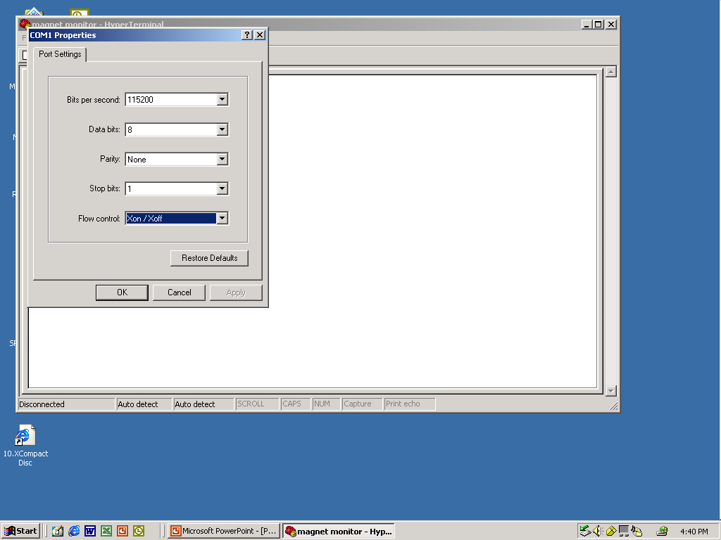
Magnet Monitor Laptop Setup
Set Flow Control to Xon/Xoff

Slide 12
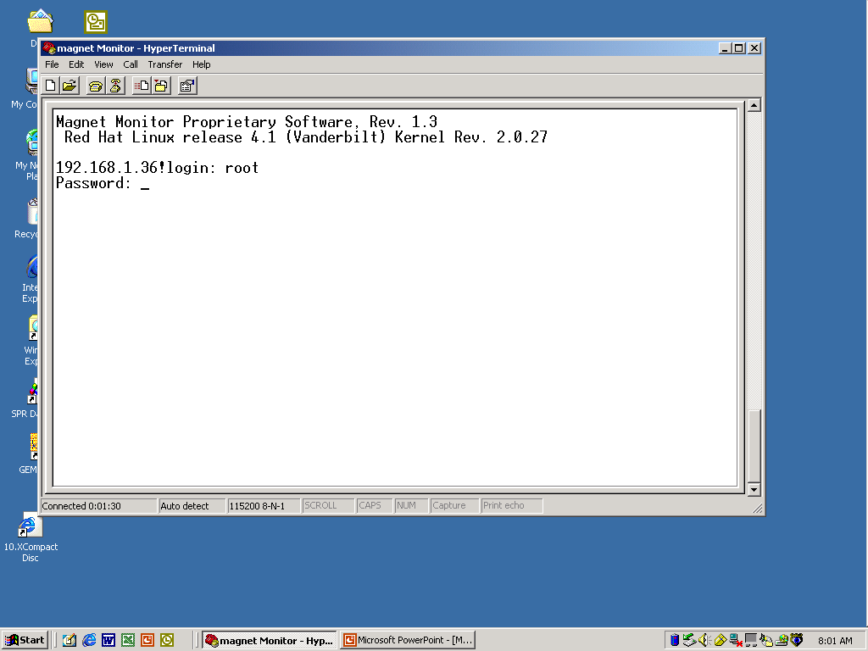
Magnet Monitor Setup
Login as: root, Password: mvserve

Slide 13
Magnet Monitor Setup
Insert Proprietary Floppy Disk into the Magnet Monitor.
NOTE: Use the correct revision of proprietary software
for the operating software running on the Magnet Monitor
2.2 for 2.2 and 2.3 for 2.3.

Slide 14
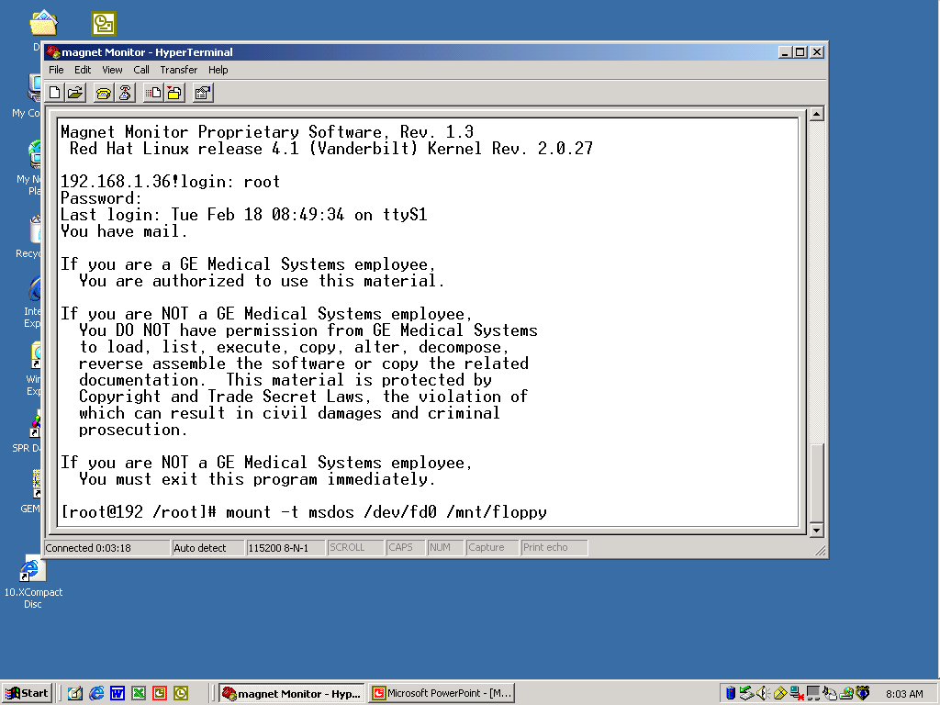
Magnet Monitor Setup
Type in: mount –t msdos /dev/fd0 /mnt/floppy

Slide 15
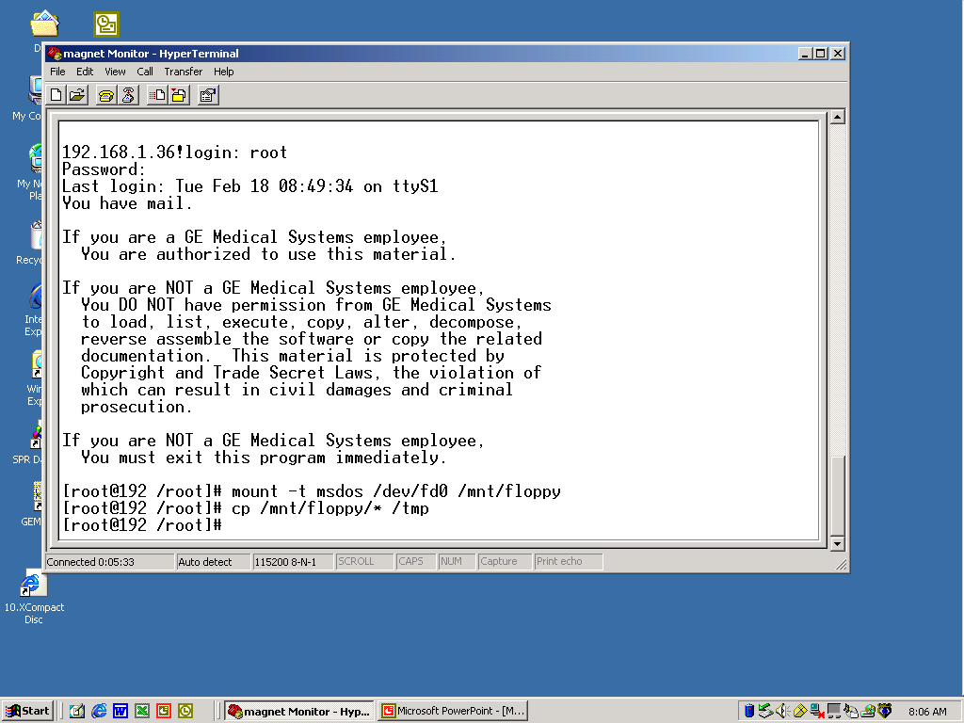
Magnet Monitor Setup
Type in: cp /mnt/floppy/* /tmp

Slide 16
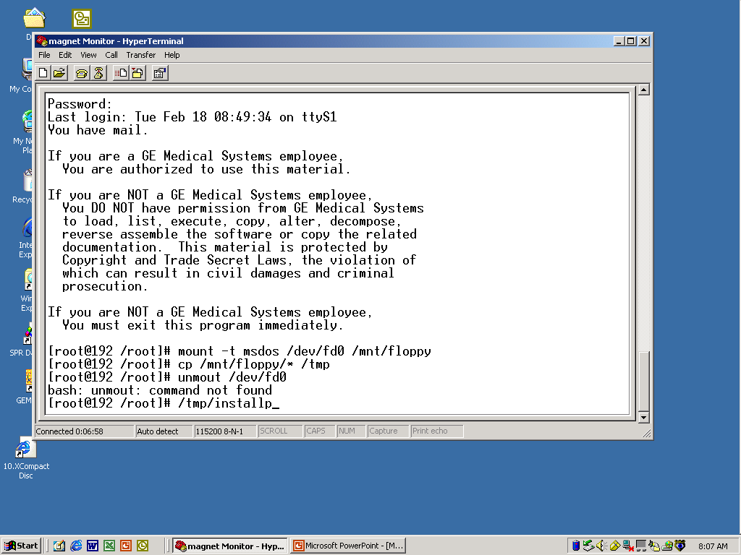
Magnet Monitor Setup
Type in: umount /dev/fd0
Type in: /tmp/installp

Slide 17
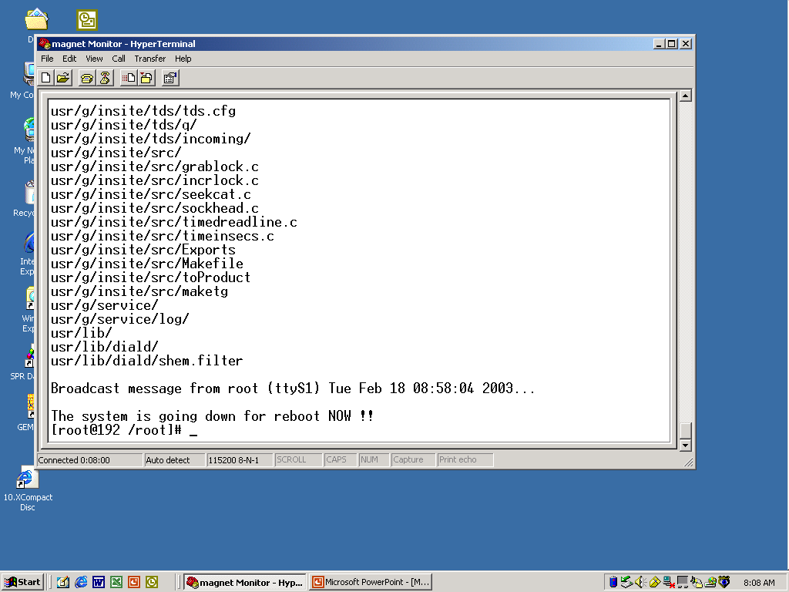
Magnet Monitor Setup
The Magnet Monitor will now reboot

Slide 18
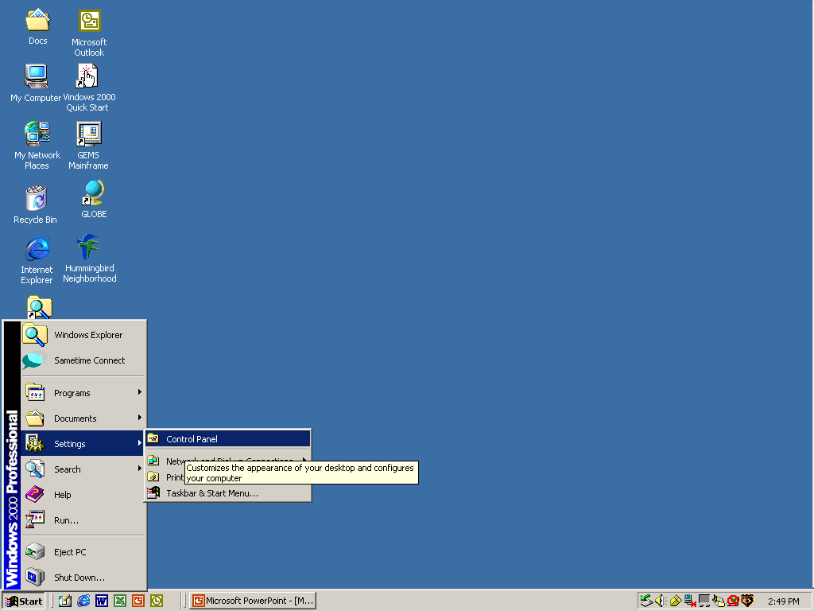
Magnet Monitor Browser Setup
Select: “Control Panel” from Settings

Slide 19
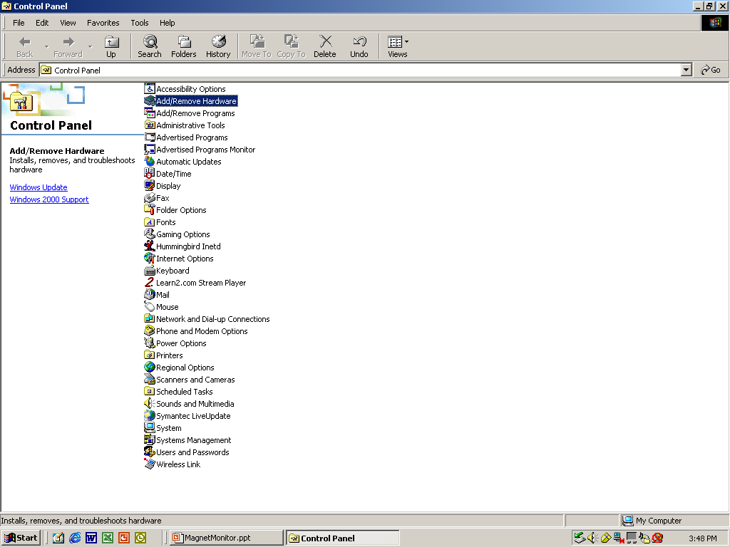
Magnet Monitor Browser Setup
Select: Add/Remove Hardware

Slide 20
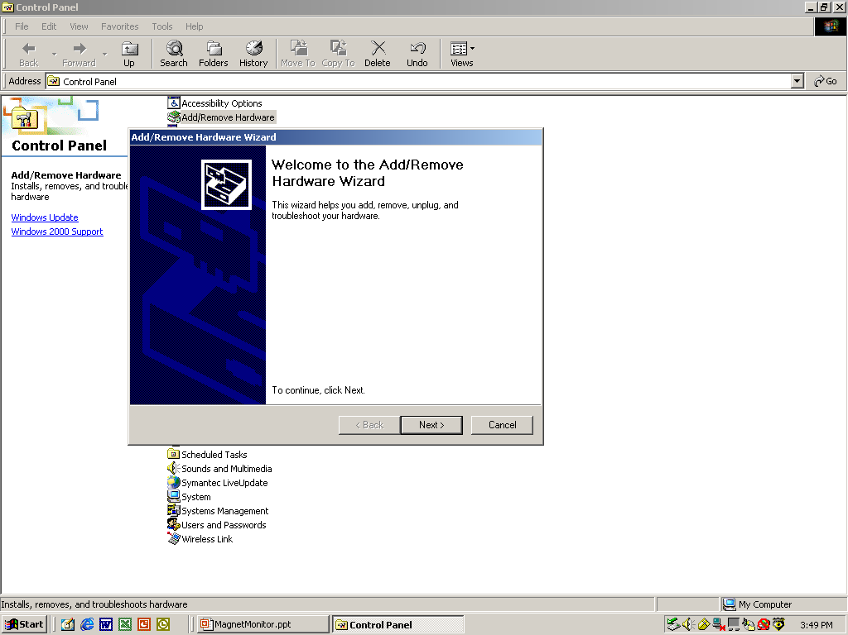
Magnet Monitor Browser Setup
Click on the Next button.

Slide 21
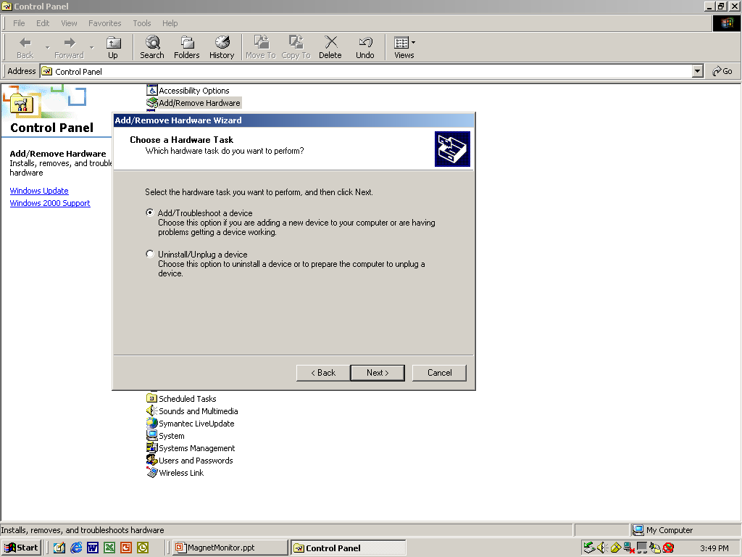
Magnet Monitor Browser Setup
Select: Add/Troubleshoot~ then click Next.

Slide 22
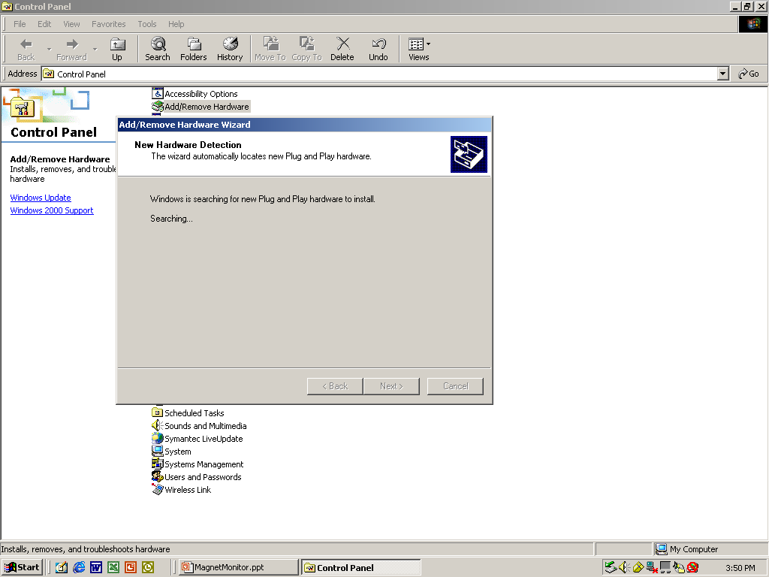
Magnet Monitor Browser Setup
The Plug and Play wizard will search
for new hardware and find none.

Slide 23
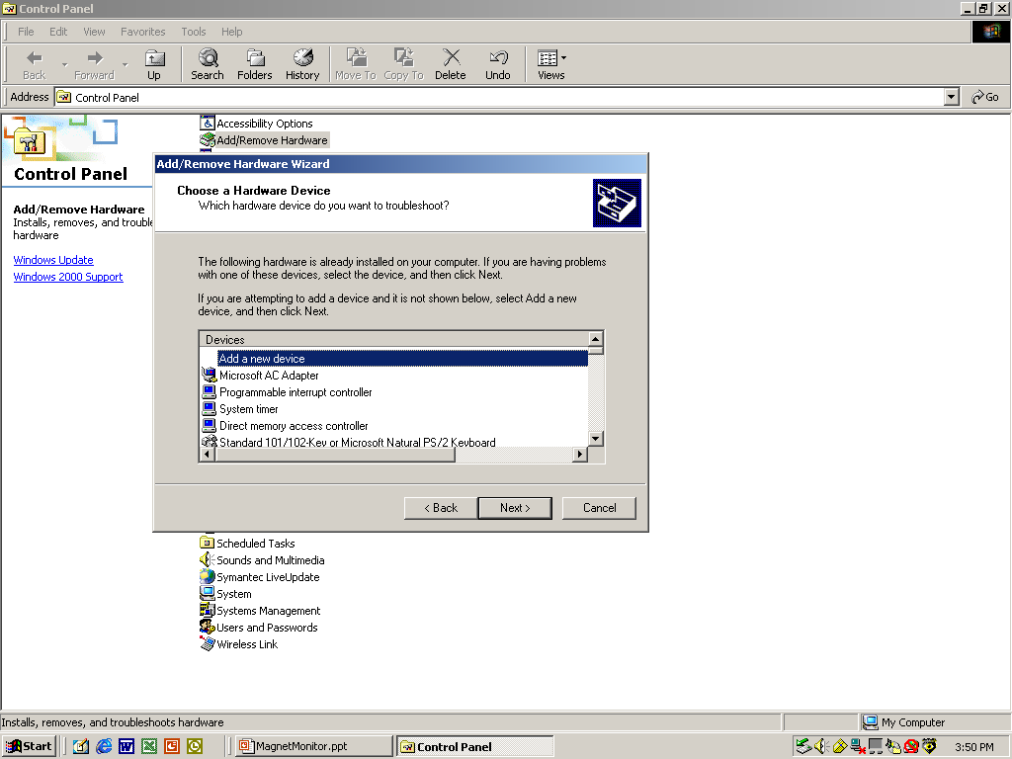
Magnet Monitor Browser Setup
Select: Add new device

Slide 24
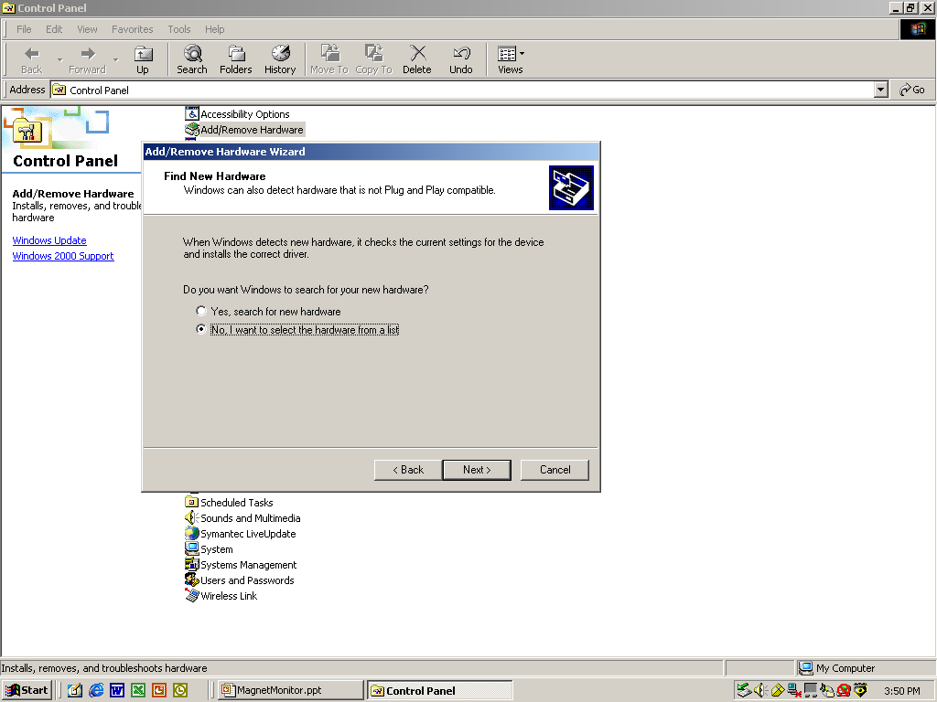
Magnet Monitor Browser Setup
Select: No, I want to select~ then Click Next.

Slide 25
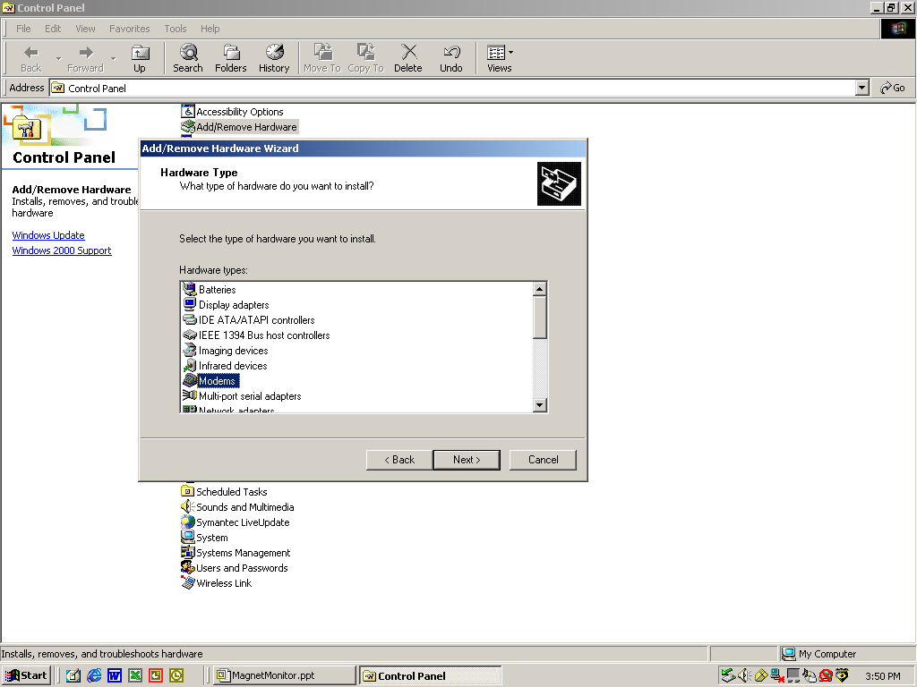
Magnet Monitor Browser Setup
Select Modem and click on Next.

Slide 26
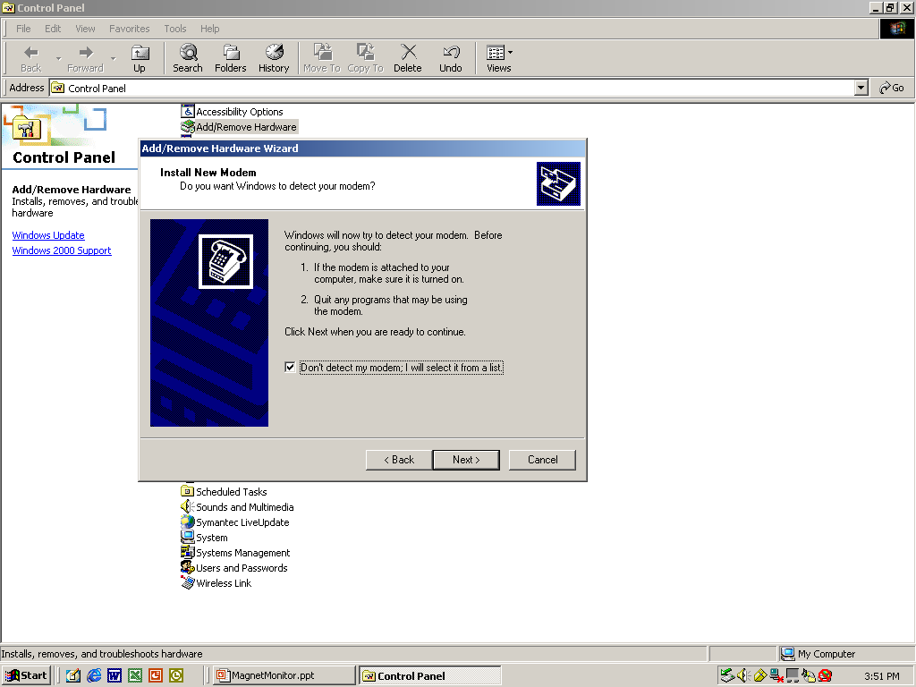
Magnet Monitor Browser Setup
Select: Don’t detect my modem~ then Click Next.

Slide 27
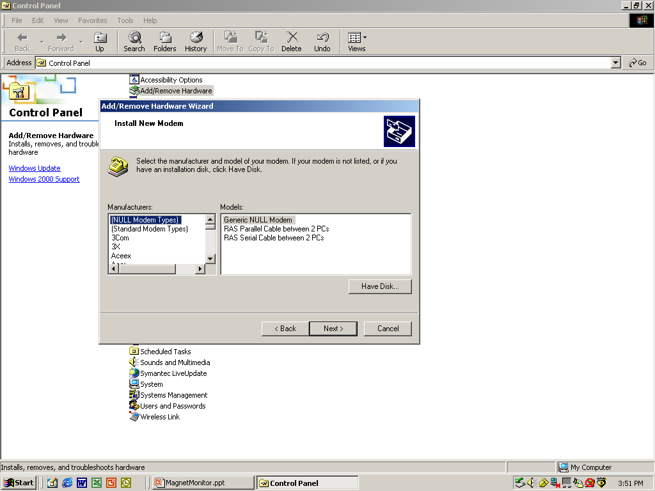
Magnet Monitor Browser Setup
Select: Generic NULL Modem then Click Next.
NOTE: If the NULL Modem Types are not listed, put
the Proprietary Floppy Disk in the Laptop and click
on the Have Disk button.

Slide 28
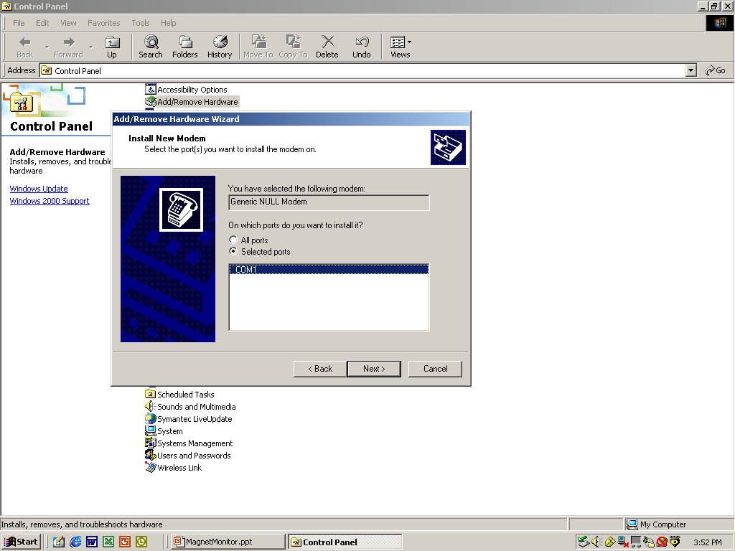
Magnet Monitor Browser Setup
Select: COM1 then Click Next.

Slide 29
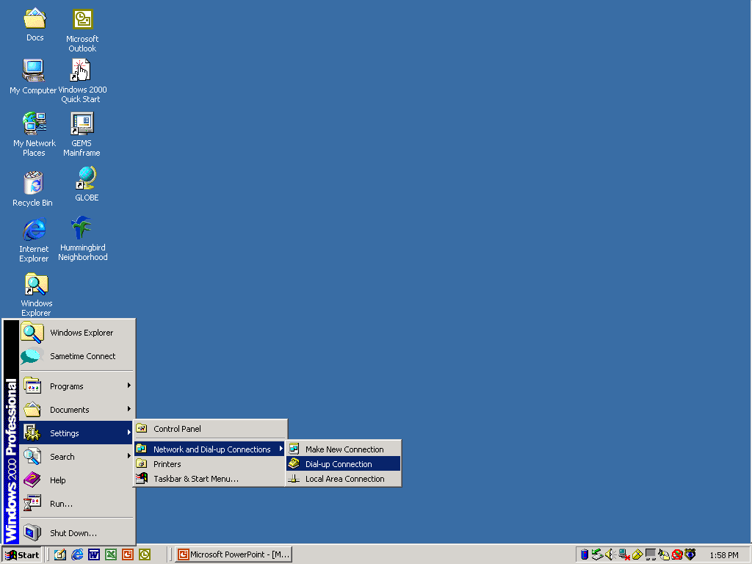
Browser Connection to Magnet Monitor
Select: Settings>Network and Dial-up Connection>Dial-up Connection

Slide 30
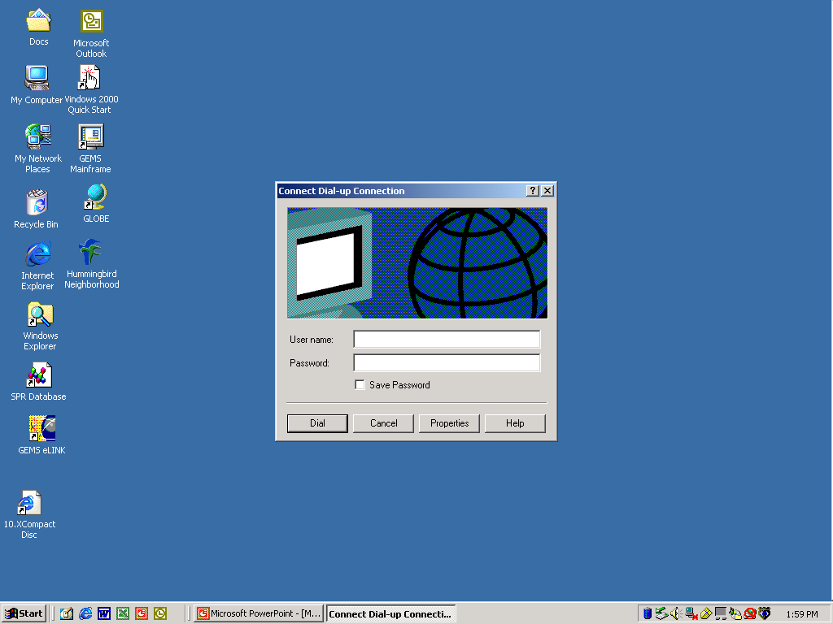
Browser Connection to Magnet Monitor
Click on the Properties button.

Slide 31
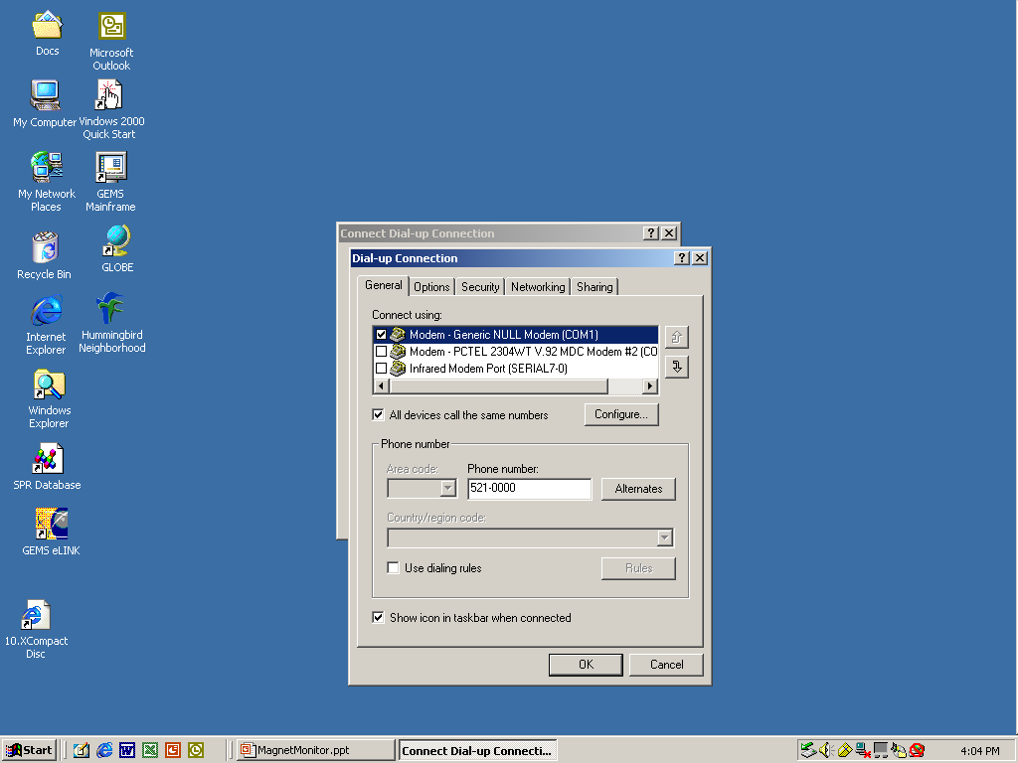
Browser Connection to Magnet Monitor
Click on the Configure… button.

Slide 32
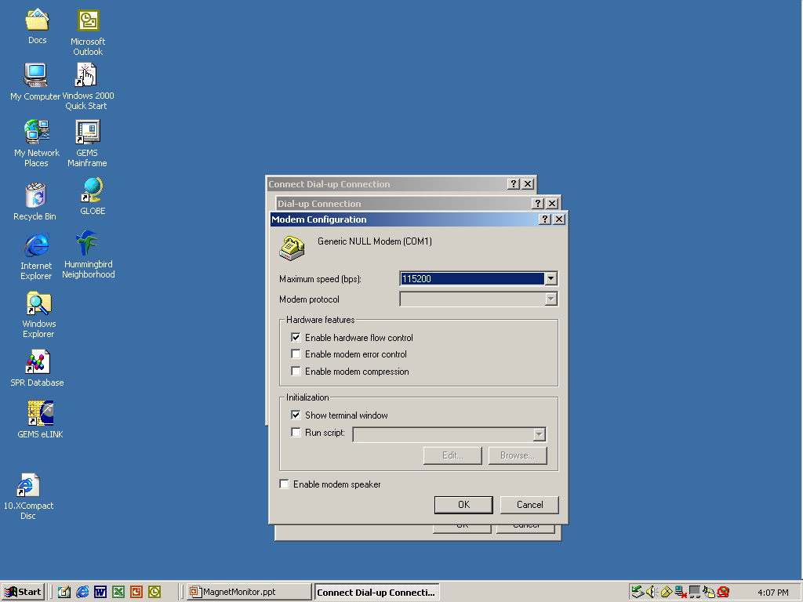
Browser Connection to Magnet Monitor
Check Max speed, it should be 115200.
Enable hardware flow control and Show
Terminal window boxes should be selected,
then click OK.

Slide 33
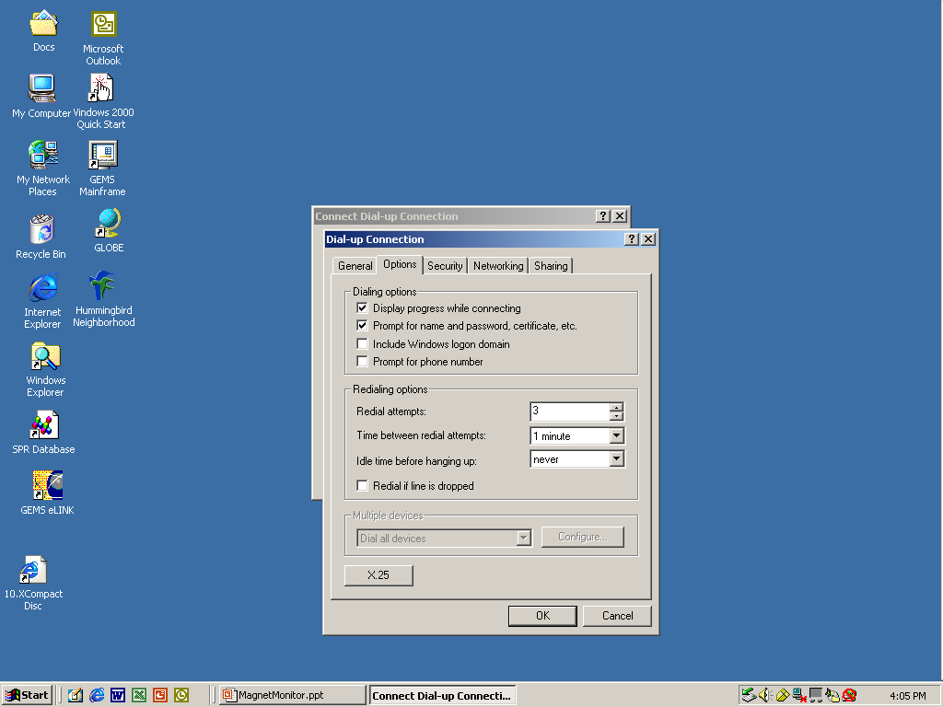
Browser Connection to Magnet Monitor
Click on the Options tab to check the following:
Display progress while connecting and Prompt
for name and password, certificate, etc. boxes.
These need to be selected, then click OK.

Slide 34
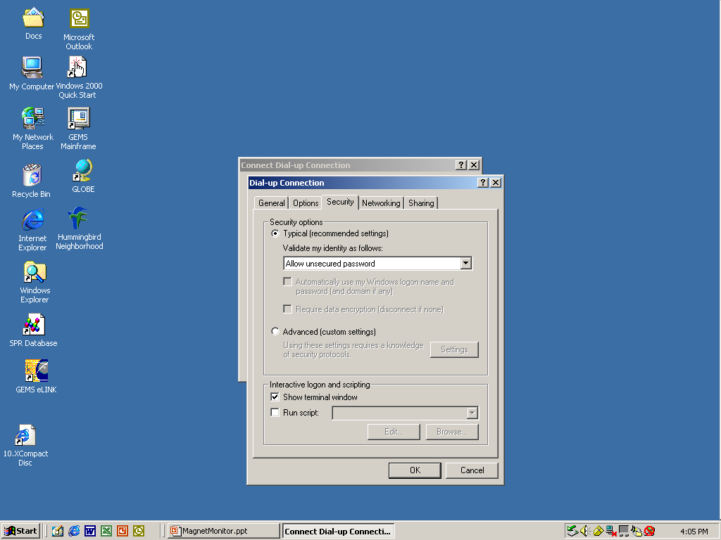
Browser Connection to Magnet Monitor
Click on the Security tab and check the following:
Typical and Show terminal window should be
selected, then click OK.

Slide 35
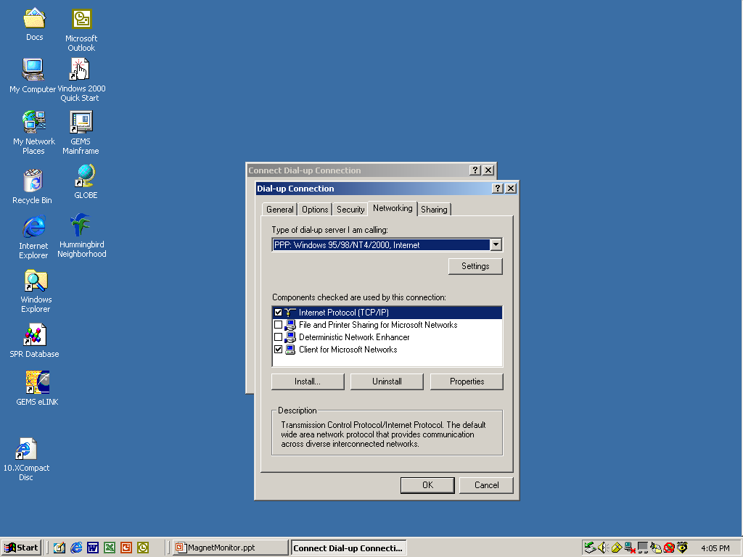
Browser Connection to Magnet Monitor
Click on the Networking tab and check the following:
Type of dial-up, PPP:Windows 95/98/NT4/2000. Internet
TCP/IP and Client for Microsoft Networks should be
Selected, then click OK.

Slide 36

Browser Connection to Magnet Monitor
Click on the Sharing tab and check the following:
For local network: Local Area Connection should be
selected, then click OK.

Slide 37
Browser Connection to Magnet Monitor
Click on the OK button when done checking.

Slide 38
Browser Connection to Magnet Monitor
Click on the Dial button to start connection.

Slide 39
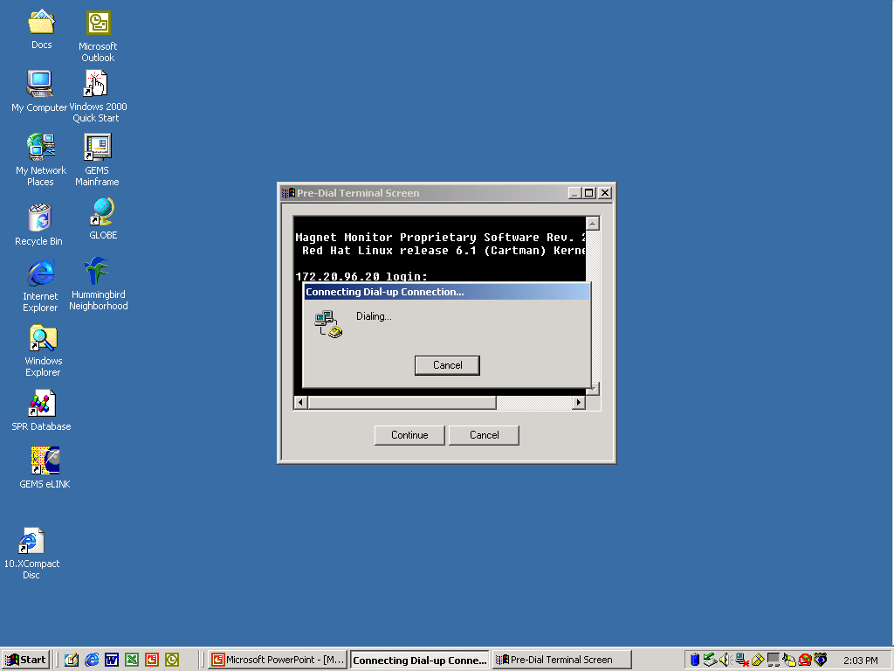
Browser Connection to Magnet Monitor
The Pre-Dial Terminal Screen will pop up.

Slide 40
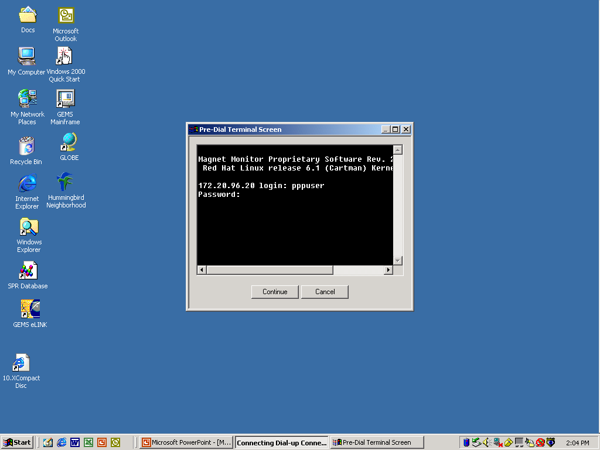
Browser Connection to Magnet Monitor
Login as “pppuser” with password “insite”.

Slide 41
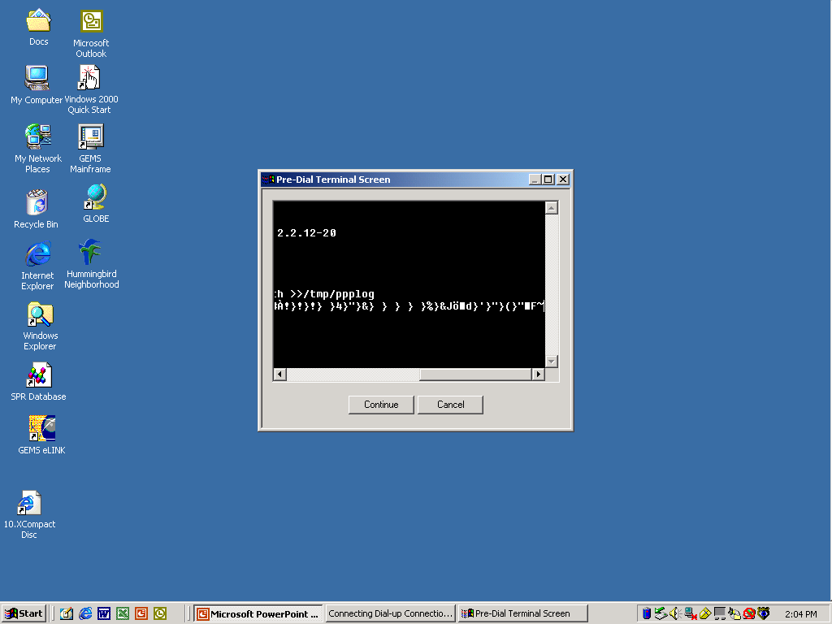
Browser Connection to Magnet Monitor
The Pre-Dial Terminal Screen starts connecting.

Slide 42
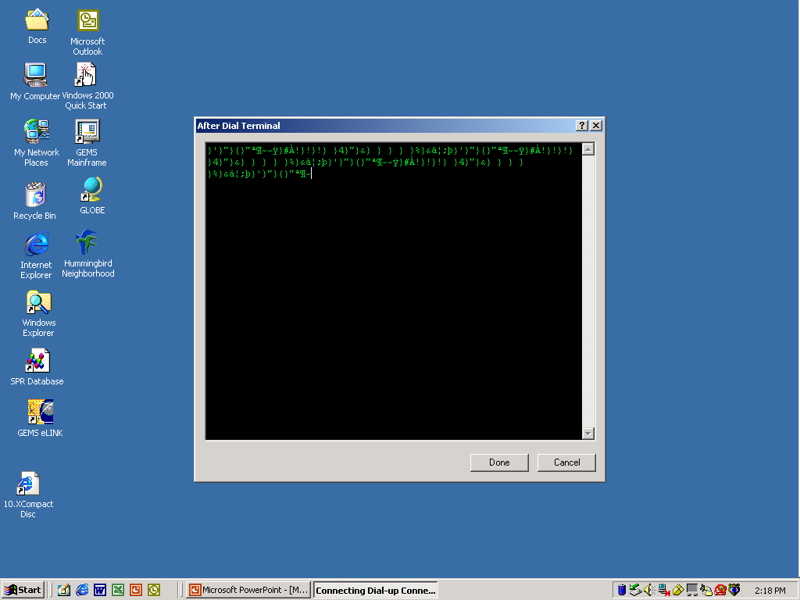
Browser Connection to Magnet Monitor
The After Dial Terminal screen will appear
and a string of characters will show up, at
that time press the Done button.

Slide 43
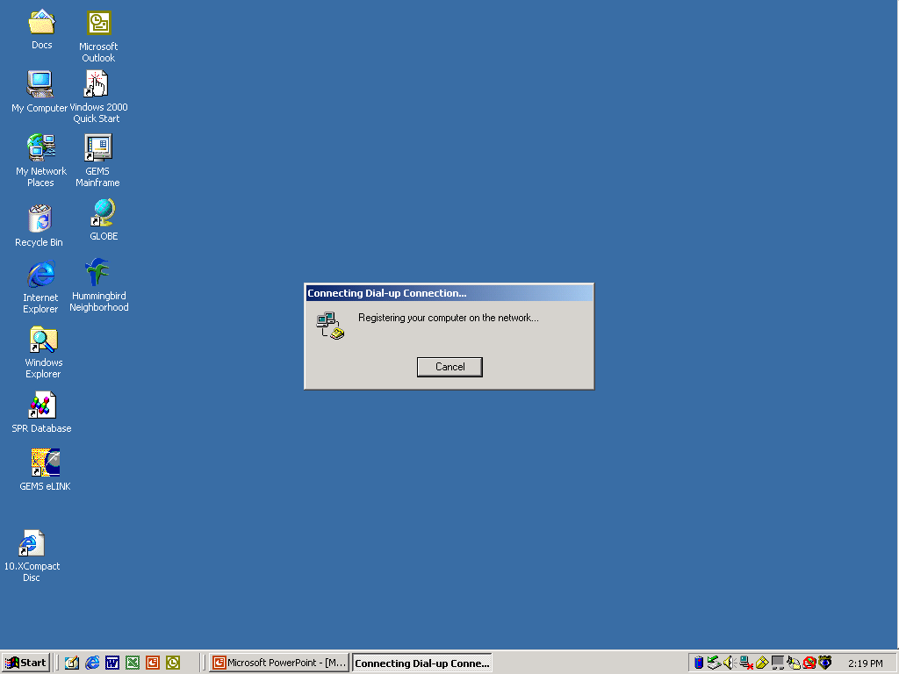
Browser Connection to Magnet Monitor
The Connecting Dial-up Connection window
will pop up for a time.

Slide 44
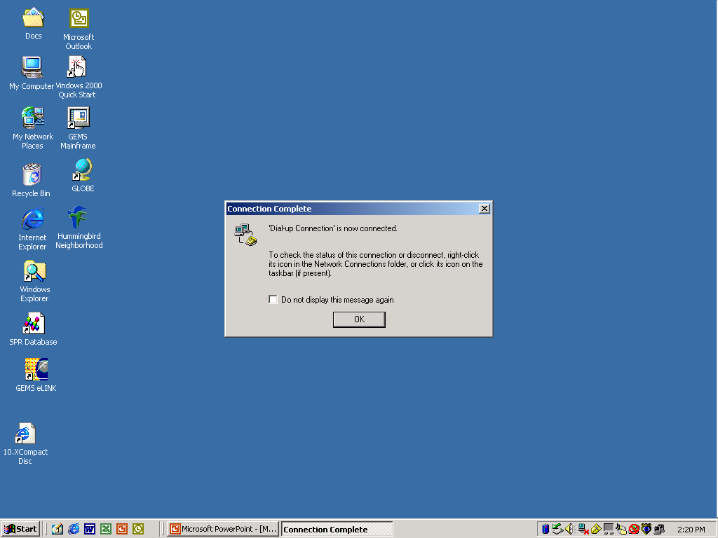
Browser Connection to Magnet Monitor
Then the Connection Complete window
will appear. Click OK.

Slide 45
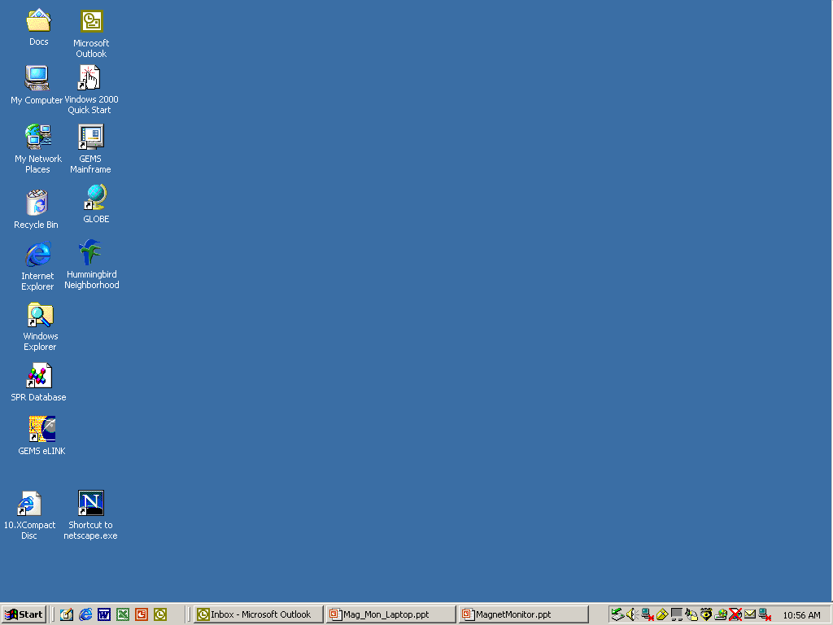
Netscape Navigator Setup
Open up netscape browser.

Slide 46
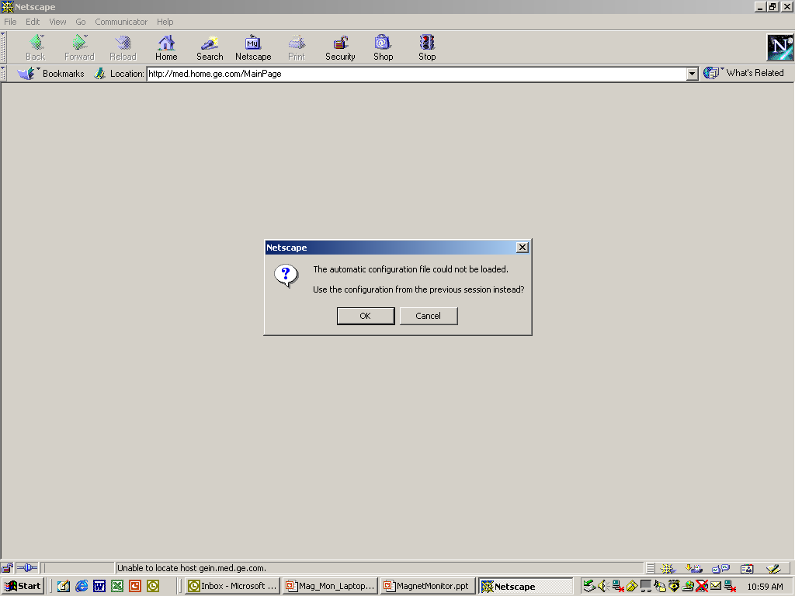
Netscape Navigator Setup
Click on OK for automatic configuration error.

Slide 47
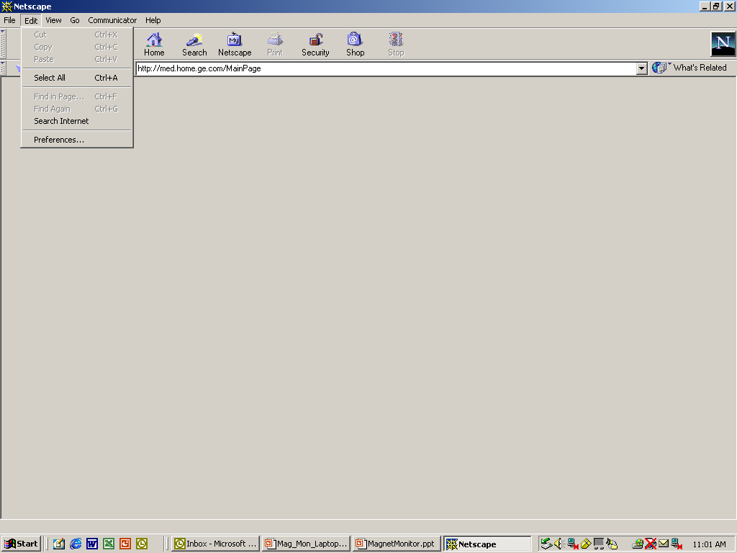
Netscape Navigator Setup
Click on EDIT and select Preferences
from the pull down menu.

Slide 48
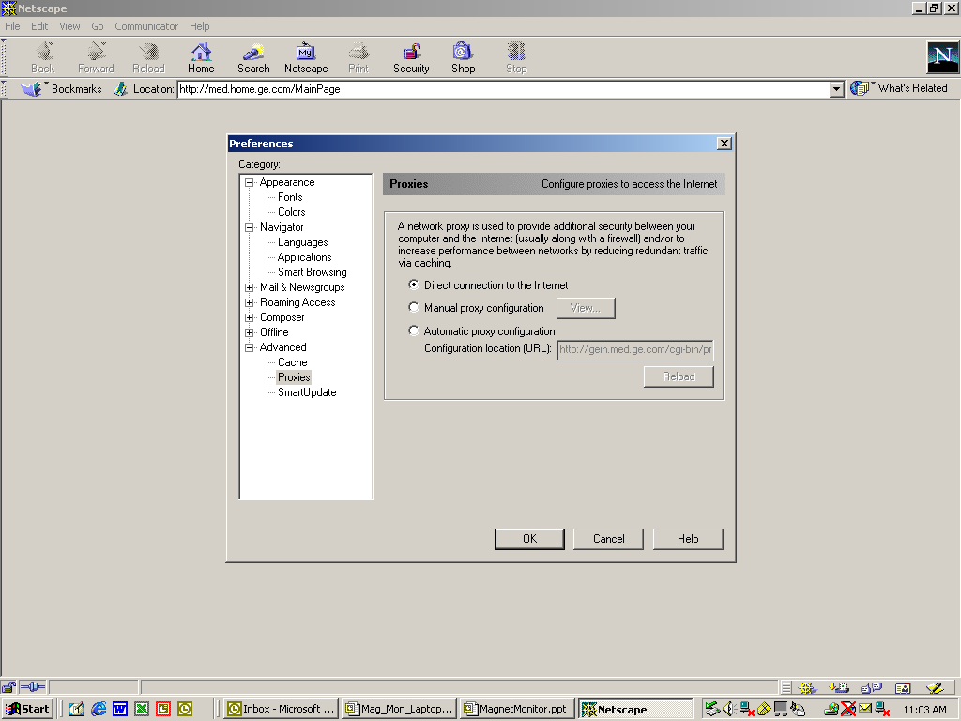
Netscape Navigator Setup
In the Preferences box, select Proxies and
enable Direct connection to the Internet.

Slide 49
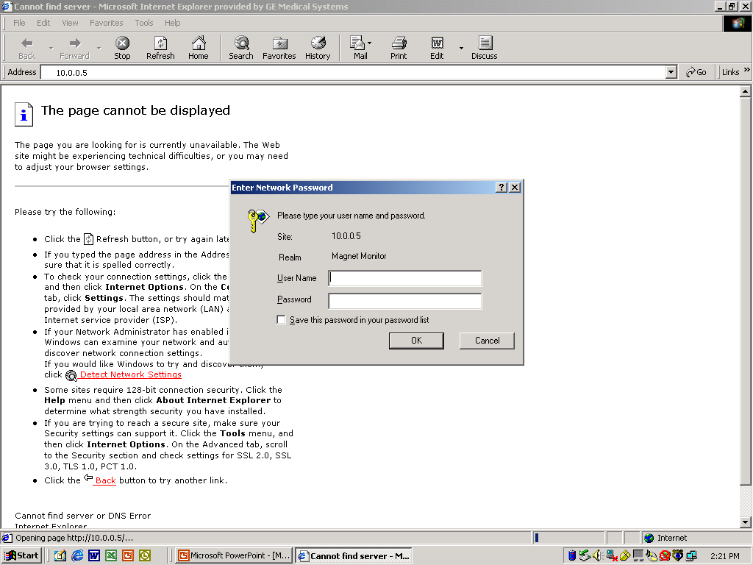
Browser Connection to Magnet Monitor
Open the Browser and enter the IP Address 10.0.0.5 or the IP Address that was assigned to the Magnet Monitor.

Slide 50
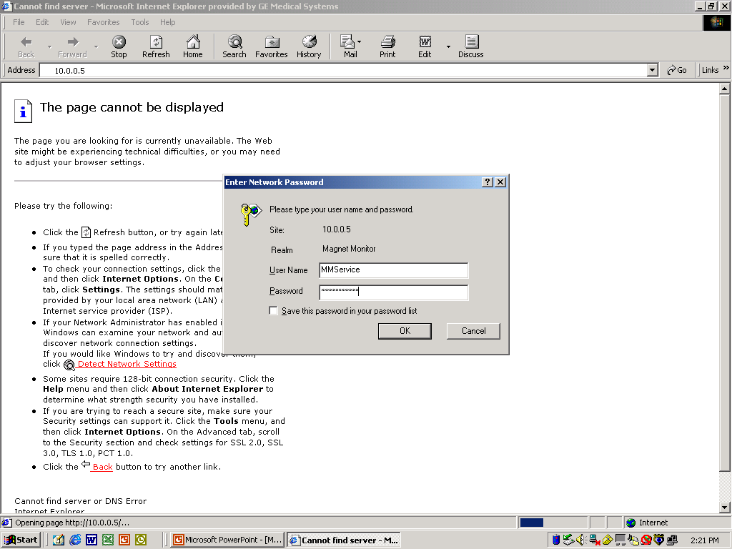
Browser Connection to Magnet Monitor
Enter the User Name: MMService
Password: MagnetMonitor

Slide 51
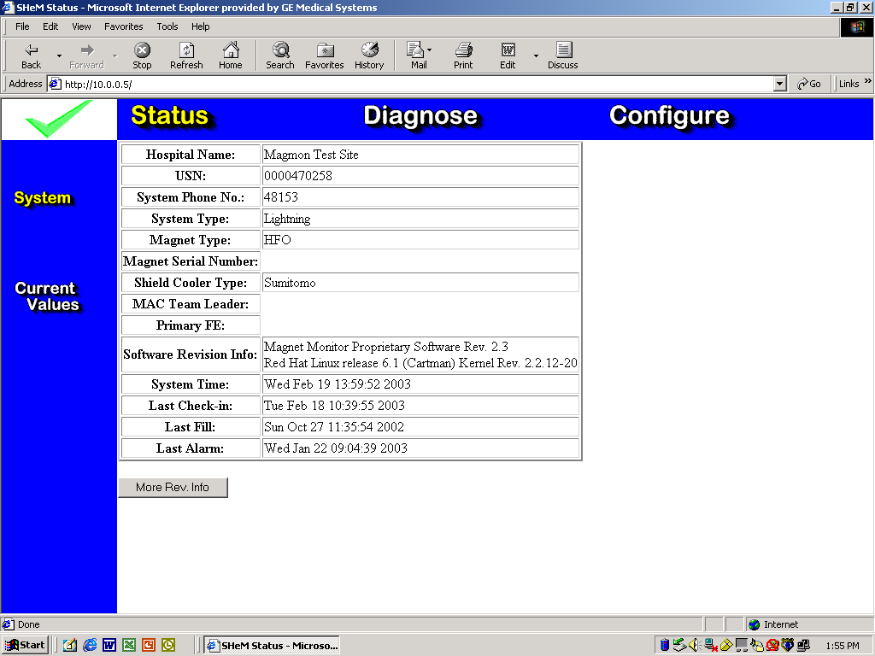
Browser Connected to Magnet Monitor
The Magnet Monitor Status screen will appear.

Slide 52

Browser Connected to Magnet Monitor
Current Values Screen

Slide 53

Browser Connected to Magnet Monitor
Diagnose screen with Tables/day selected.

Slide 54

Browser Connected to Magnet Monitor
Diagnose screen with Graphs/minute selected.

Slide 55

Terminating The Browser Connection
After the Browser is closed, the Dial-up
Connection should also be closed.

Slide 56

Magnet Monitor Physical Connection
The two connectors may not fit well

Slide 57
Simplified Boiloff Troubleshooting
Cooling
50% of all boiloff is from the compressor being off – chiller issues
25% of all boiloff is due to a bad coldhead
ALWAYS ASK 5 QUESTIONS (regardless of magnet type)
  Compressor Run Time (tells if the compressor has been off = high boiloff)
  Cryocooler Temps (if less than spec, do not change coldhead or compressor)
  Compressor Pressure (if it’s low, efficiency will be bad and temps may be high)
  Magnet Pressure
  Chilled Water Temps and Flows
  See charts for specs by magnet type

Slide 58


Slide 59


Slide 60
END OF SLIDE SHOW
$$$

